Slide 1


Foundations
John Beverley
Assistant Professor, University at Buffalo
Co-Director, National Center for Ontological Research
Affiliate Faculty, Institute of Artificial Intelligence and Data Science

Slide 2
Outline
Intelligence Successes and Failures
Characterizing Intelligence
Design Patterns 101

Slide 3
Outline
Intelligence Successes and Failures
Characterizing Intelligence
Design Patterns 101

Slide 4
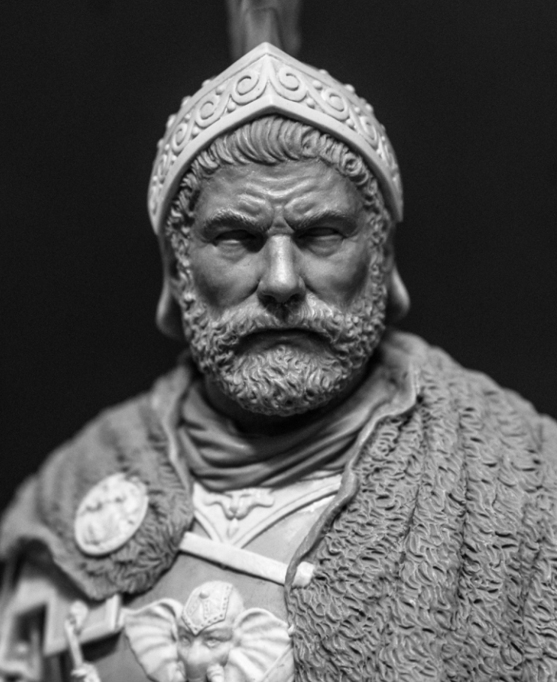
Battle of Cannae
216 BCE Second Punic War
Romans raised an army of ~70,000 troops to push Hannibal from the pennisula, some of whom were Celtic warriors from nearby regions
Some of whom were spies for Hannibal...

Slide 5
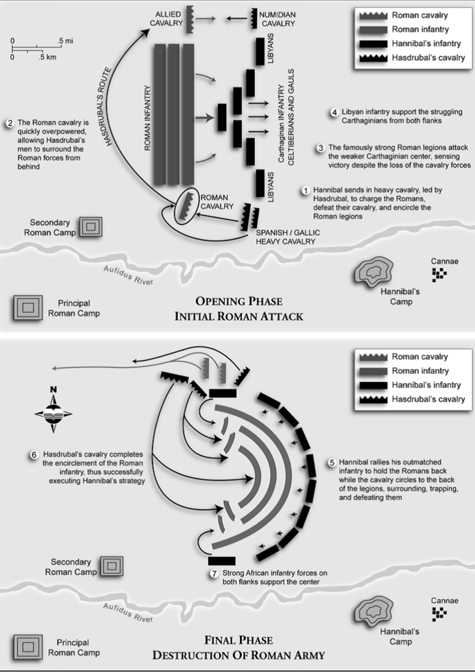
Battle of Cannae
Romans had experienced soldiers push through the center of Hannibal’s troops, with the goal of splitting his army
Hannibal placed weakest troops in the center, flanked by elite troops

Slide 6
Battle of Cannae
As the Romans pushed the center, Hannibal’s weakest troops gave ground and the elite troops moved to encircle the Roman army
60,000 Roman soldiers were killed in this battle
~20% of adult male Roman population

Slide 7
Japan Invades the Philippines
1942 during World War II, just after the U.S. had entered the war
Douglas MacArthur, commander of the United States Armed Forces in the Far East, stationed in the Philippines, was forced to retreat
Long-term strategic planning by Japanese military resulted in spies infilitrating U.S. and Philippine organizations
For example, it is reported that a gardner for the Philippine governor was a high-ranking Japanese military officer

Slide 8
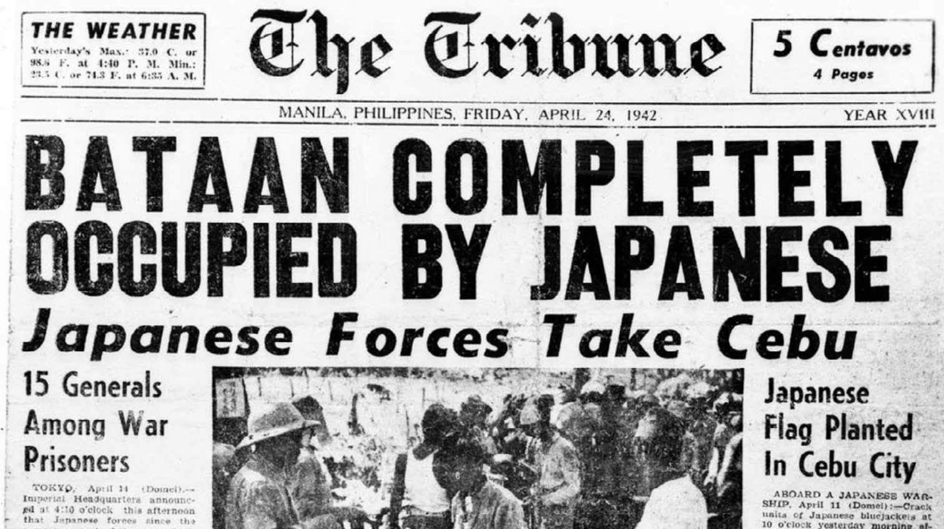
Notes:
Japan bombing Pearl Harbor in 1941
German invasion of Russia in 1941
Outbreak of hostilities between the US and Korea in 1950
Iranian attack on Kuwait in 1990

Slide 9
Double-Edged Sword
These examples illustrate both intelligence analysis failures and successes
The failure of Roman consuls to acquire and leverage intelligence while battling Hannibal was compounded by Hannibal’s proclivity for leveraging intelligence
The intelligence failures of the U.S. and Philippine military forces were magnified by the long-term intelligence strategies deployed by the Japanese military

Slide 10
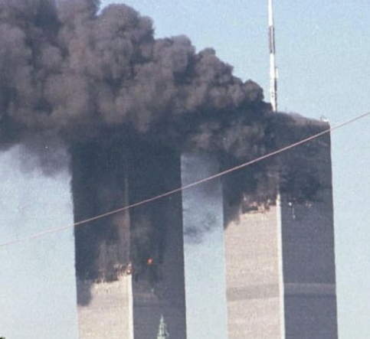
9/11
2001, four U.S. commercial airplanes were hijacked by members of Al-Queda intending to crash them into the Twin Towers, the Pentagon, and Washington D.C.
All were successful with the exception of the planned crash in D.C.
The Twin Towers collapsed; nearly 3,000 people were killed in the attacks

Slide 11
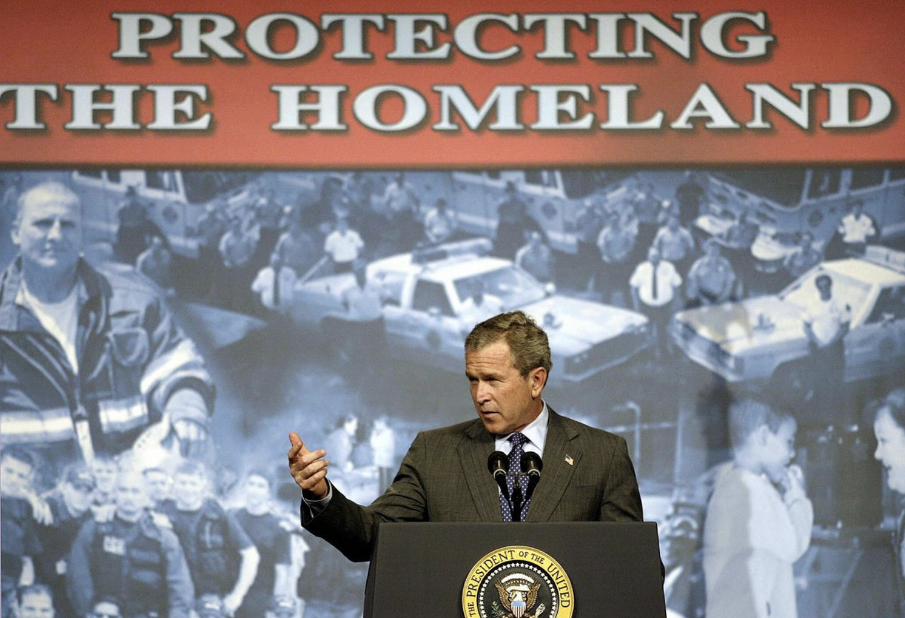
9/11
Resulting investigations revealed U.S. intelligence agencies knew Al-Queda was mobilizing, but information was not shared freely across agencies
At the time the NSA considered itself an intelligence curator; if an agency asked whether Al-Queda was mobilizing, they’d confirm
Few people knew to ask...

Slide 12

Double-Edged Sword
The 9/11 attacks were magnified by failures of intelligence sharing across U.S. government agencies
The U.S. government established the Patriot Act to ensure such failures did not happen again
Expanding surveillance capabilities of law enforcement and easing information flow between agencies

Slide 13
Outline
Intelligence Successes and Failures
Characterizing Intelligence
Design Patterns 101

Slide 14
“Intelligence” in Natural Language
“Intelligence” is spoken of in many ways
Entities can be considered intelligent, e.g. Einstein, Aristotle, Fido the dog, Hal the computer
Or exhibit intelligence, e.g. performing well on an exam, read a defense, offer a quick quip
Activities can be considered intelligent as well, e.g. chess strategy, Hannibal’s encirclement strategy

Slide 15
“Intelligence” for our Purposes
Even putting aside these uses of “intelligent” and “intelligence”, the sense of “intelligence” within our scope is also spoken of in many ways...
Traditionally, such intelligence has been viewed – roughly – as a strategic process to guide decision-making and avoid surprises
Open-sourcing, issues arising from big data, and the emerging transnational nature of intelligence agencies motivated the need for more precision

Slide 16
Sample Characterizations of Intelligence
Form or power, not unlike military power or economic power (Herman, 1996)
Information that allows policymakers or operational commanders, to make more effective decisions (Warner, 2002)
Either a process through which intelligence is requested by superiors, then collected, analysed, and fed to the consumers, or a product distributed through multilevel secure electronic databases, or institutions, e.g. intelligence services (Lowenthal, 2019)

Slide 17
Sample Characterizations of Intelligence
Form or power, not unlike military power or economic power (Herman, 1996)
Information that allows policymakers or operational commanders, to make more effective decisions (Warner, 2002)
Either a process through which intelligence is requested by superiors, then collected, analysed, and fed to the consumers, or a product distributed through multilevel secure electronic databases, or institutions, e.g. intelligence services (Lowenthal, 2019)
Underspecified, what differentiates it from other powers?
Knowledge of the location of a coffee maker facilitates more effective decisions...
Can’t one have intelligence not requested by superiors or distributed in databases? Are institutions really understood to be “intelligence”

Slide 18
Definition Construction 101
We are aiming towards a precise definition of “intelligence” that is narrow enough to exclude many natural language uses, but broad enough to serve as a common starting point for more specific definitions
Intelligence
“Intelligence” in natural language
Military
Intelligence
Criminal
Intelligence

Slide 19
Definition Construction 101
We are aiming towards a precise definition of “intelligence” that is narrow enough to exclude many natural language uses, but broad enough to serve as a common starting point for more specific definitions
Intelligence
“Intelligence” in natural language
Military
Intelligence
Criminal
Intelligence

Slide 20
Definition Construction 101
We are aiming towards a precise definition of “intelligence” that is narrow enough to exclude many natural language uses, but broad enough to serve as a common starting point for more specific definitions
Intelligence
“Intelligence” in natural language
Military
Intelligence
Criminal
Intelligence

Slide 21
Definition Construction 101
We are aiming towards a precise definition of “intelligence” that is narrow enough to exclude many natural language uses, but broad enough to serve as a common starting point for more specific definitions
Intelligence
“Intelligence” in natural language
Military
Intelligence
Criminal
Intelligence

Slide 22
Definitions 101
For any definition there is a term defined – T – and the expression or expressions – E – defining that term
A definition is a pair <T, E>
For any definition and any domain, T is true of that domain just in case E is true of that domain
Triangle =_{def} A polygon with three edges and three vertices

Slide 23
Evaluating Definitions
Evaluating a definition then involves at least two steps:
Assume T is true of a domain, attempt to find a scenario in which E is not
Assume E is true of a domain, attempt to find a scenario in which T is not
Triangle =_{def} A polygon with three edges and three vertices
The preceding is a good definition; any triangle is a polygon with three edges and vertices; any polygon with three edges and vertices is a triangle

Slide 24
Evaluating Definitions
Evaluating a definition then involves at least two steps:
Assume T is true of a domain, attempt to find a scenario in which E is not
Assume E is true of a domain, attempt to find a scenario in which T is not
Human Being =_{def} A featherless biped

Slide 25
Evaluating Definitions
Evaluating a definition then involves at least two steps:
Assume T is true of a domain, attempt to find a scenario in which E is not
Assume E is true of a domain, attempt to find a scenario in which T is not
Human Being =_{def} A featherless biped
The preceding is an infamous definition attributed to Plato; Diogenes the Cynic famously plucked a chicken and proclaimed “Behold, a man!”

Slide 26
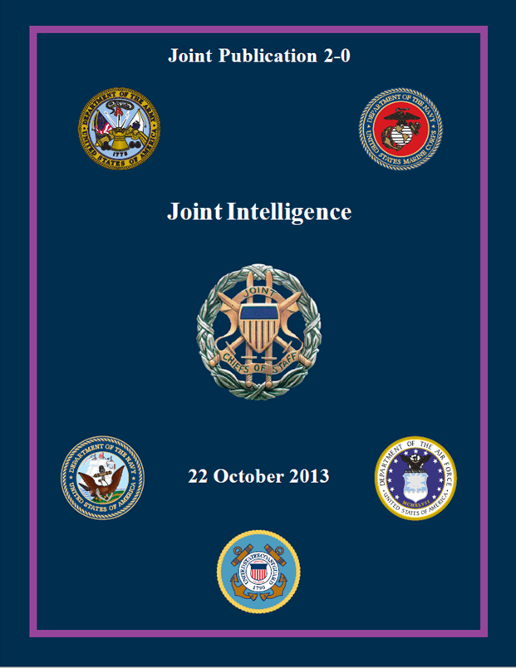
Joint Publication 2.0 Definitions
Intelligence =_{def} The product resulting from the collection, processing, integration, evaluation, analysis, and interpretation of available information concerning foreign nations, hostile or potentially hostile forces or elements, or areas of actual or potential operations, as well as the activities that result in the product and the organizations engaged in such activities.
Joint Intelligence =_{def} Intelligence produced by elements of more than one service of the same nation.

Slide 27
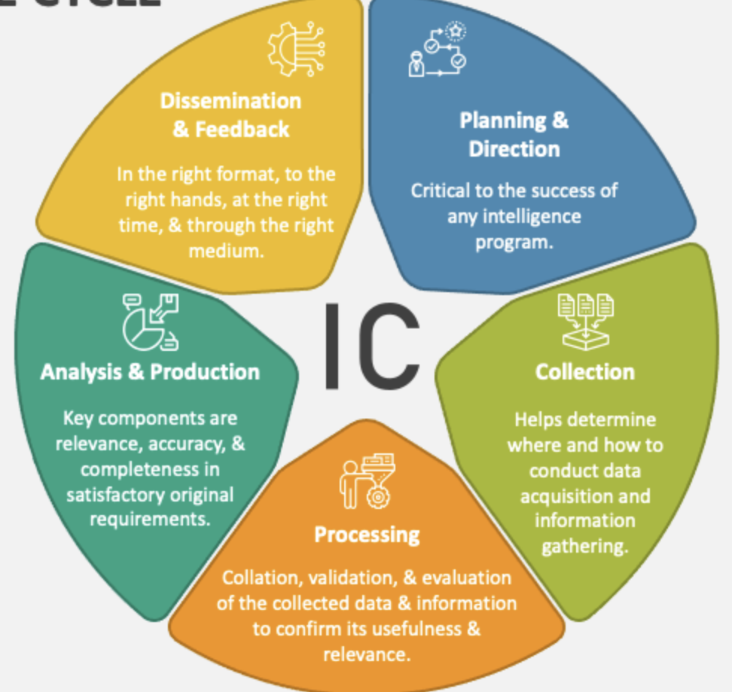
Joint Publication 2.0 Definition
Intelligence =_{def} The product resulting from the collection, processing, integration, evaluation, analysis, and interpretation of available information concerning foreign nations, hostile or potentially hostile forces or elements, or areas of actual or potential operations, as well as the activities that result in the product and the organizations engaged in such activities.
Intelligence Cycle

Slide 28
Joint Publication 2.0 Definition
Intelligence =_{def} The product resulting from the collection, processing, integration, evaluation, analysis, and interpretation of available information concerning foreign nations, hostile or potentially hostile forces or elements, or areas of actual or potential operations, as well as the activities that result in the product and the organizations engaged in such activities.

Slide 29
Joint Publication 2.0 Definition
Intelligence =_{def} The product resulting from the collection, processing, integration, evaluation, analysis, and interpretation of available information concerning foreign nations, hostile or potentially hostile forces or elements, or areas of actual or potential operations, as well as the activities that result in the product and the organizations engaged in such activities.

Slide 30
Joint Publication 2.0 Definition
Intelligence =_{def} The product resulting from the collection, processing, integration, evaluation, analysis, and interpretation of available information concerning foreign nations, hostile or potentially hostile forces or elements, or areas of actual or potential operations, as well as the activities that result in the product and the organizations engaged in such activities.

Slide 31
Joint Publication 2.0 Definition
Intelligence =_{def} The product resulting from the collection, processing, integration, evaluation, analysis, and interpretation of available information concerning foreign nations, hostile or potentially hostile forces or elements, or areas of actual or potential operations, as well as the activities that result in the product and the organizations engaged in such activities.
Implicit is that there must be some reason members of agency ABC believe forces are, for example, potentially hostile

Slide 32
Joint Publication 2.0 Definition
Intelligence =_{def} The product resulting from the collection, processing, integration, evaluation, analysis, and interpretation of available information concerning foreign nations, hostile or potentially hostile forces or elements, or areas of actual or potential operations, as well as the activities that result in the product and the organizations engaged in such activities.
These reasons for gathering intelligene are importantly distinct from intelligence itself

Slide 33
Joint Publication 2.0 Definition
Intelligence =_{def} The product resulting from the collection, processing, integration, evaluation, analysis, and interpretation of available information concerning foreign nations, hostile or potentially hostile forces or elements, or areas of actual or potential operations, as well as the activities that result in the product and the organizations engaged in such activities.
Counterexamples:
Intelligence ≠ Intelligence Gathering Activity
Agents getting proper sleep shouldn’t count as intelligence

Slide 34
Joint Publication 2.0 Definition
Intelligence =_{def} The product resulting from the collection, processing, integration, evaluation, analysis, and interpretation of available information concerning foreign nations, hostile or potentially hostile forces or elements, or areas of actual or potential operations, as well as the activities that result in the product and the organizations engaged in such activities.
Counterexamples:
The CIA itself is not intelligence; it gathers intelligence
An agency’s HR department doesn’t gather intelligence

Slide 35
Joint Publication 2.0 Definition
Intelligence =_{def} The product resulting from the collection, processing, integration, evaluation, analysis, and interpretation of available information concerning foreign nations, hostile or potentially hostile forces or elements, or areas of actual or potential operations, as well as the activities that result in the product and the organizations engaged in such activities.
That aside, this is clearly specific to military intelligence, and so could not serve as a general definition

Slide 36
Joint Publication 2.0 Definition
Intelligence =_{def} The product resulting from the collection, processing, integration, evaluation, analysis, and interpretation of available information concerning foreign nations, hostile or potentially hostile forces or elements, or areas of actual or potential operations, as well as the activities that result in the product and the organizations engaged in such activities.
Counterexamples:
Police gather intelligence on domestic criminal activity
Companies gather intelligence prior to merger

Slide 37
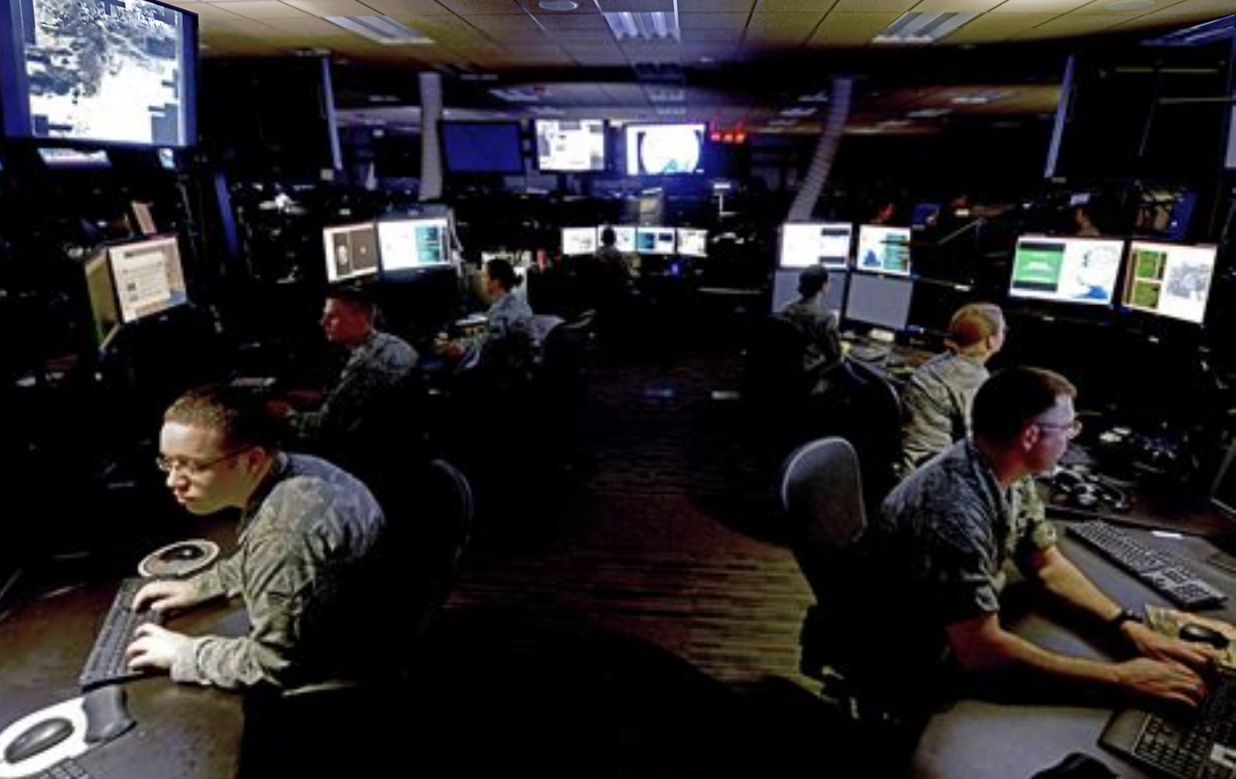
Complicating our Terms
In addition to cutting across different users, intelligence cuts across numerous targets:
Criminals
Corporations
Nations
Militaries
Non-profits
You

Slide 38
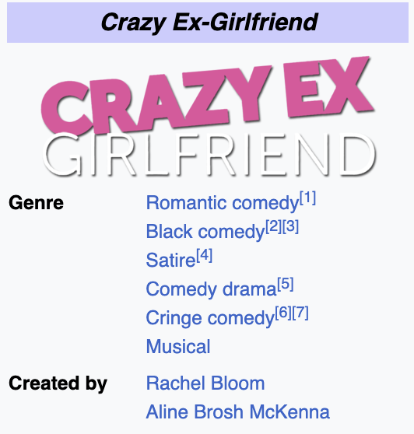

Complicating our Terms
In addition to cutting across different users, intelligence cuts across numerous targets:
Criminals
Corporations
Nations
Militaries
Non-profits
You

Slide 39
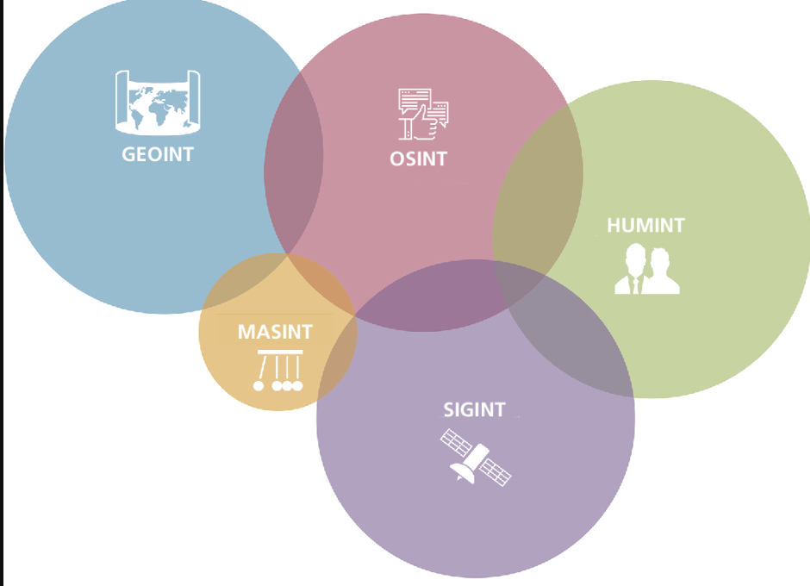
Complicating our Terms
As well as cutting across numerous sources:
Open-Source (OSINT)
Human (HUMINT)
Imagery (IMINT)
Signals (SIGINT)
Measurement (MASINT)
Geographic (GEOINT)

Slide 40
Outline
Intelligence Successes and Failures
Characterizing Intelligence
Design Patterns 101

Slide 41
Competency Question
Competency questions represent functional requirements for ontologies; they are used to evaluate the quality of ontologies with respect to user goals
Competency question used for this demo:
Has a drone crossed the Arizona-Mexico border?

Slide 42


Three Drone Border Crossing Scenarios
Flat, Linear Path
Climbing Linear Path
Flat Non-Linear Path
Each flight path is a way in which a drone might cross the a US border.

Slide 43
Ontology Design
Addressing the competency question requires ontologically representing data relevant to the question
For our example, we will need representations of:
border/boundary
geographic region
drone
speed
latitude
altitude
longitude
time

Slide 44
Ontology Design
Addressing the competency question requires ontologically representing data relevant to the question
For our example, we will need representations of:
border/boundary
geographic region
drone
speed
latitude
altitude
longitude
time

Slide 45
Definition of Boundary
Fiat Line Boundary =def A continuous flat line whose location is defined in relation to some material entity.
The MX-AZ border is an instance of the class Fiat Line Boundary.
Fiat Line Boundary
We visually represent this relationship with an
oval for the class Fiat Line Boundary, a diamond for the instance MX-AZ border, and an arrow indicating the latter is a type of the former.
type
MX-AZ border

Slide 46
Ontology Design
Addressing the competency question requires ontologically representing data relevant to the question
For our example, we will need representations of:
border/boundary
geographic region
drone
speed
latitude
altitude
longitude
time

Slide 47
Definition of Geographic Region
Geographic Region =def A geographic entity demarcated by one or more boundaries all of whose lines are located on the Earth’s surface.
The MX-AZ border is located in some instance of Geographic Region, which has parts corresponding to parts of the border
The geographic parts are associated with latitude and longitudes, represented by, for simplicity, decimal values represented by rectangles
geographic part a
has lon value
decimal
has lat value
decimal

Slide 48
Representing Borders
Class
Instance
Value
Fiat Line Boundary
Geographic Region
KEY
geographic part a
has lon value
decimal
type
type
has part
has lat value
decimal
MX-AZ border
geographic region
located in
has part
geographic part b
has lon value
decimal
has lat value
decimal

Slide 49
Ontology Design
Addressing the competency question requires ontologically representing data relevant to the question
For our example, we will need representations of:
border/boundary
geographic region
drone
speed
latitude
altitude
longitude
time

Slide 50
Definitions of Drone, Motion
Drone
Drone =def An aircraft designed to be powered, fly autonomously or be piloted remotely, without a human operator onboard
Motion Process =def A process in which a material entity changes its spatial orientation over time
An instance of drone participates in an instance of a motion process
type
drone
participates in
motion process
type
Motion Process

Slide 51
Process Profile, Definition of Speed
A process profile is an abstraction of some relevant aspect of a given process, e.g. the velocity of traveling missile
Speed =def A process profile characterized by the magnitude of an object’s motion relative to a reference frame over time
A drone participating in a motion process will have some associated speed value
Speed
type
speed
speed value
decimal

Slide 52
Ontology Design
Addressing the competency question requires ontologically representing data relevant to the question
For our example, we will need representations of:
border/boundary
geographic region
drone
speed
latitude
altitude
longitude
time

Slide 53
Definition of Spatiotemporal Region
Spatiotemporal Region =def An occurrent entity that is part of spacetime
The drone’s motion occupies spatiotemporal region instances which have geographic/temporal extents
Geographic extents are associated with longitude, latitude, and altitude values; temporal extents are associated with date time stamps
decimal
has lat value
geographic part 2
has alt value
decimal
has lon value
decimal
temporal interval 2
has date value
date

Slide 54
Representing Drone Motion
*Classes not diagramed due to space constraints
decimal
drone
has lat value
geographic part 2
has alt value
decimal
participates in
has geo extent
motion process
spatio temporal region
spatio temporal part 2
has lon value
has part
decimal
occupies spatiotemporal region
temporal interval 2
has profile
has interval extent
has date value
has part
date
speed
spatio temporal part 1
has geo extent
geographic part 1
has lon value
decimal
speed value
has alt value
Instance
has interval extent
decimal
decimal
has lat value
temporal interval 1
has date value
date
Value
decimal
KEY

Slide 55
Summary
In this lecture, we outlined foundations on which to begin our study of the intersection of ontology engineering and intelligence analysis
We have witnessed intelligence successes and failures, better and worse definitions of intelligence, and refined the shape of our target definition
We have, lastly, glimpsed design pattern strategies that will aid us in thinking through the complexities of intelligence analysis through an ontological lens

Slide 56
Readings
National Security Intelligence Activity: A Philosophical Analysis
Rethinking Intelligence Practices and Processes

